Slide 1

FIU GPA Tracker and Forecaster 3.0
Team Member: Camila Perez
Product Owner: Johann Henao
Instructor: Masoud Sadjadi
School of Computing and Information Sciences Florida International University

Slide 2
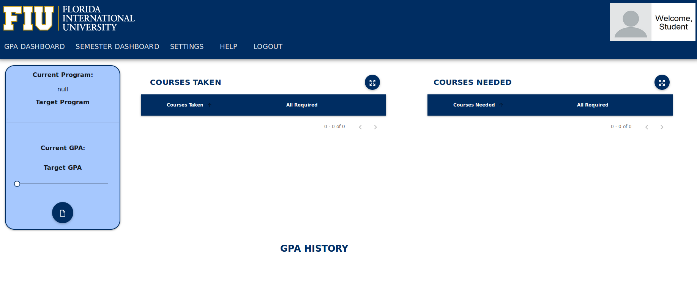
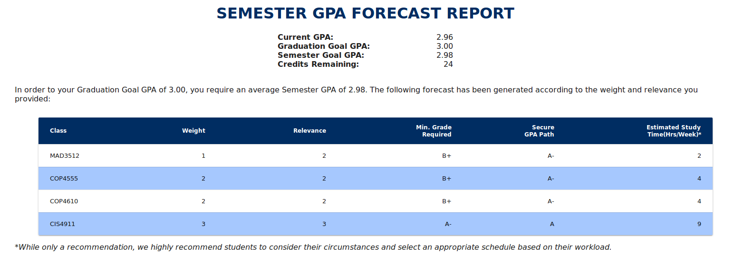
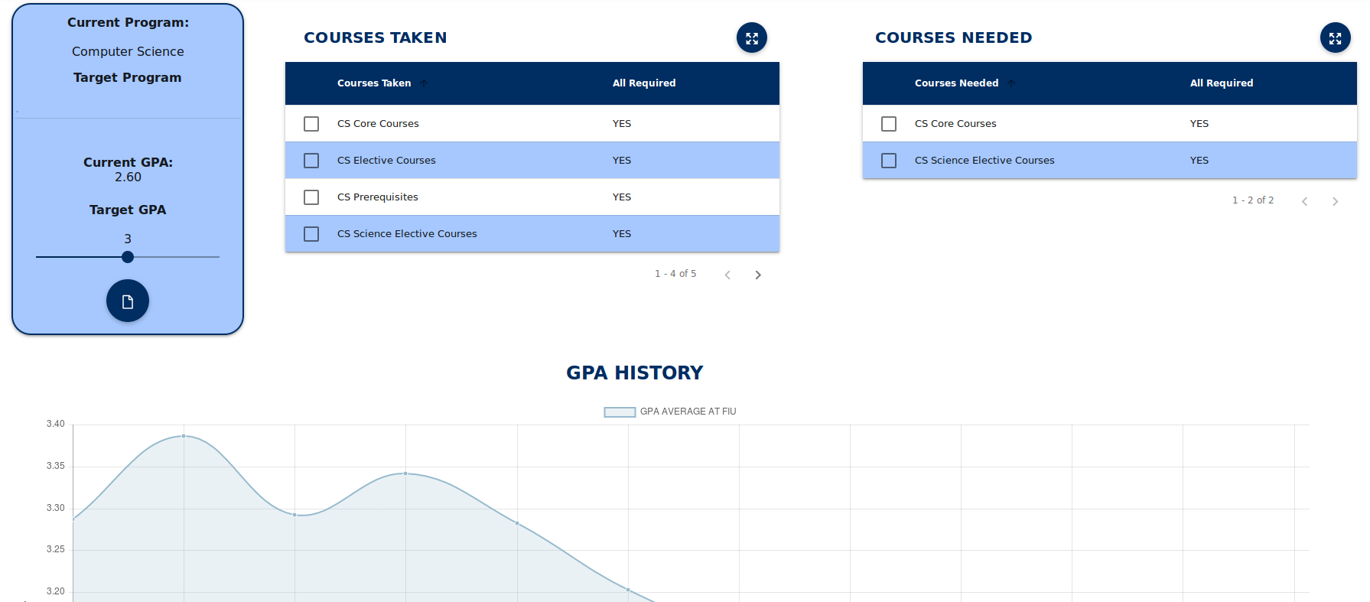
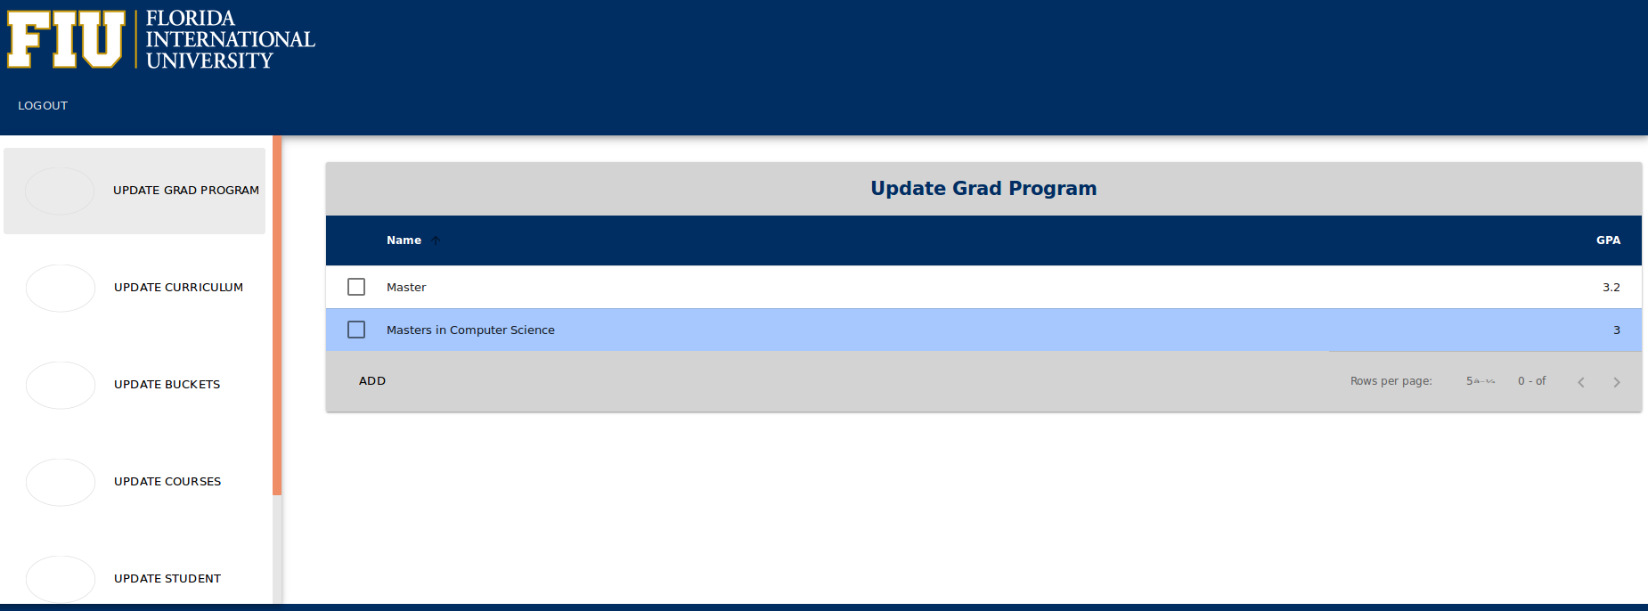
Project Definition
1. New user registers and logs in
3. Student generates semester forecast report
2. Student imports GPA Audit
4. Admin logs in

Slide 3
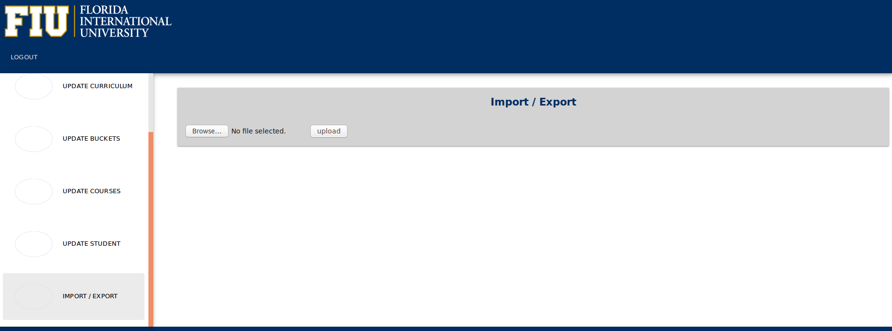
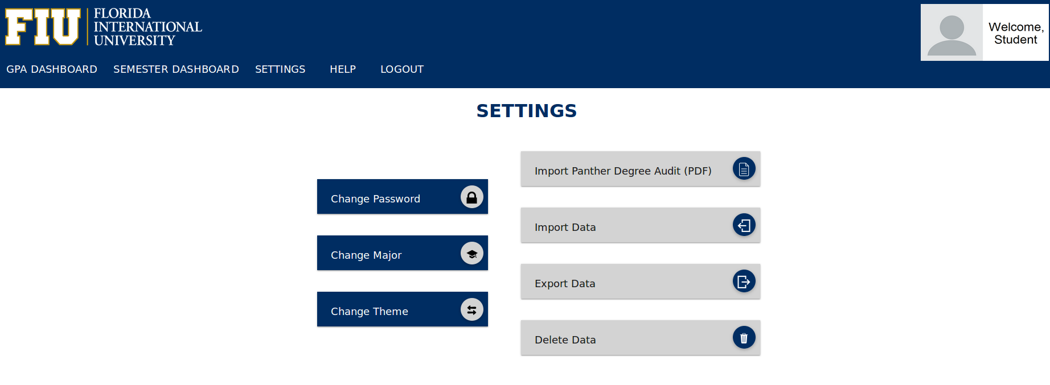
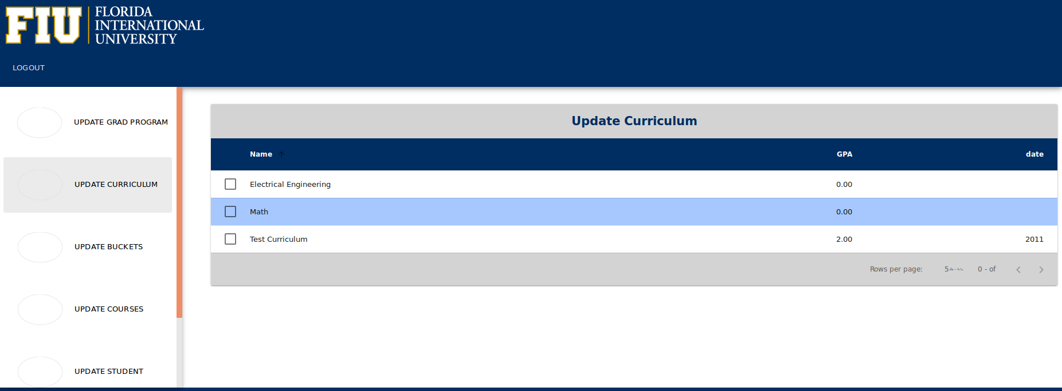
Project Definition
2. Admin imports new curriculum
1. Students can import, export, and delete their data
3. New curriculum shown in admin page

Slide 4
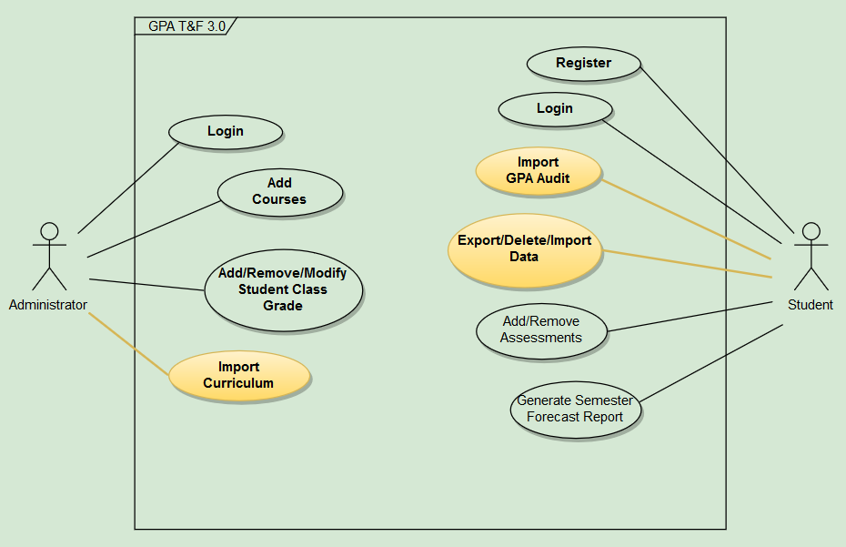
Requirements: Use Cases

Slide 5
System Design: Architecture
Controller
Web Logic
(PHP, Python)
View
Page (HTML, CSS, JS)
Model
Database

Slide 6
Minimal Class Diagram
Settings Page
Settings Controller
Semester Dashboard Page
Semester Dashboard Controller
Semester Forecast Report Page
Semester Forecast Controller
Repository
GPA Dashboard Page
GPA Dashboard Controller
GPA Forecast Report Page
GPA Forecast Controller
Admin Dashboard Page
Admin Controller

Slide 7
User Stories
1. As a developer, I want to use test drivers for the GPA Audit Import and the Program Curriculum Import so that I can test the website with different scenarios and can enable new curriculums.
2. As a developer, I would like to migrate the Settings page to AngularJS so that the page is consistent with the rest of the website.
3. As a developer, I want to fix issues pertaining the basic functionality of the Curriculum Test Drivers so that I can properly create different curriculums.
4. As an administrator, I would like to be able to import the curriculum and GPA Audit XML output from the Test Drivers so that I can automatically enable new curriculums and create new test student data.
5. As a student, I would like to use the import functionality so that I am able to recover data with an XML backup that I previously downloaded using the export functionality.
6. As a developer I would like to perform a full regression test of the GPA dashboard and fix bugs encountered so that students can properly use this page.
7. As a developer, I want to understand and document the PHP Unit Tests for the GPA Dashboard so that continued testing is allowed as new features are added to the website.

Slide 8
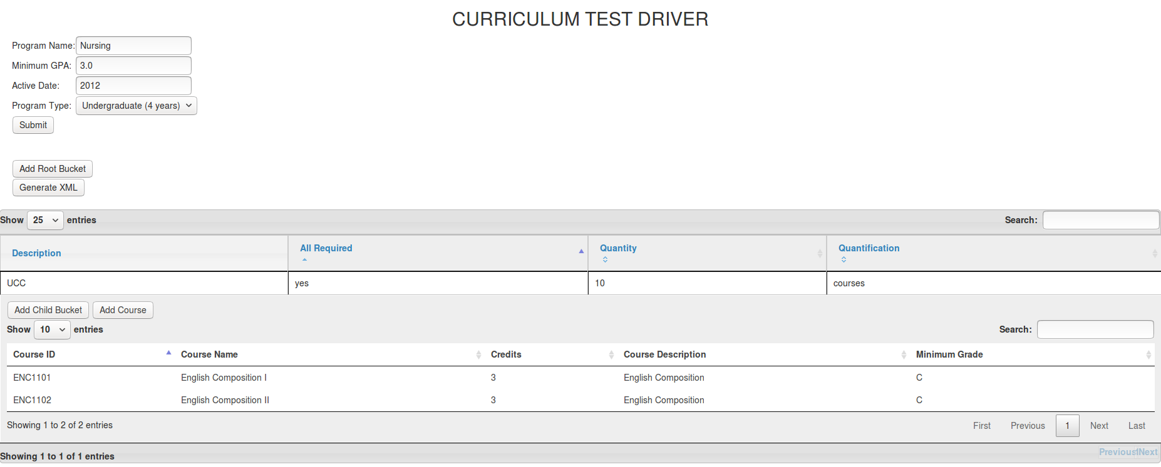
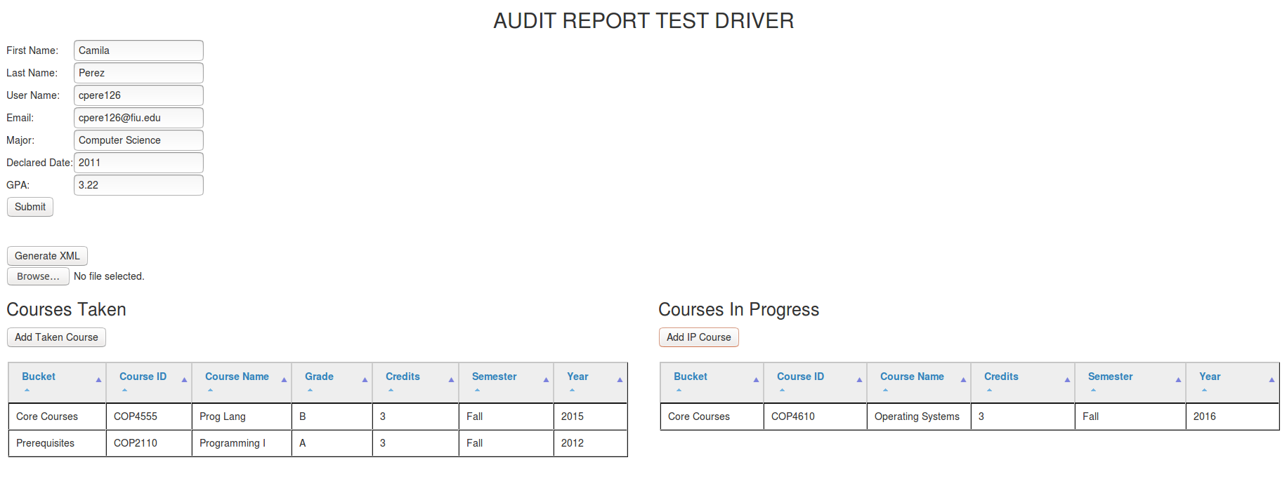
User Story #1
Create test drivers for Major Programs Import and GPA Import.
Tasks:
Create UMLs and pseudo-code.
Create basic user interface.
Develop Audit Test Driver.
Develop Curriculum Test Driver.
As fields are added to the tables, an XML DOM is updated with the new values.
jQuery DataTable
When the user clicks on the “Generate XML” button, the XML DOM is converted into a string and downloaded as an XML file.
Ajax
PHP

Slide 9
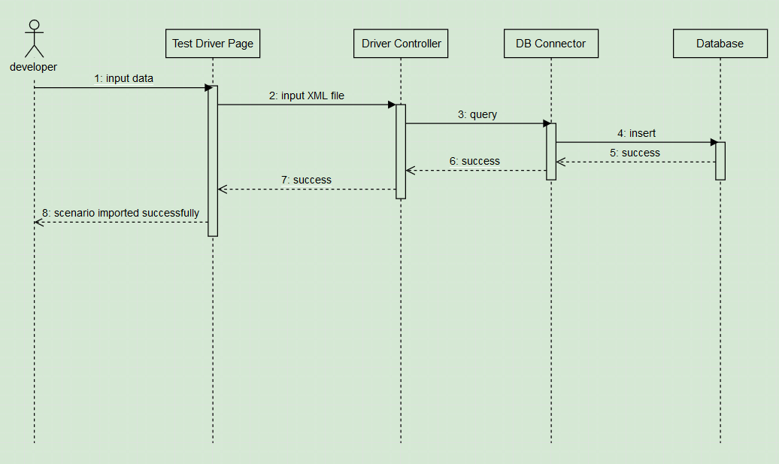
User Story #1 (Sequence Diagram)

Slide 10
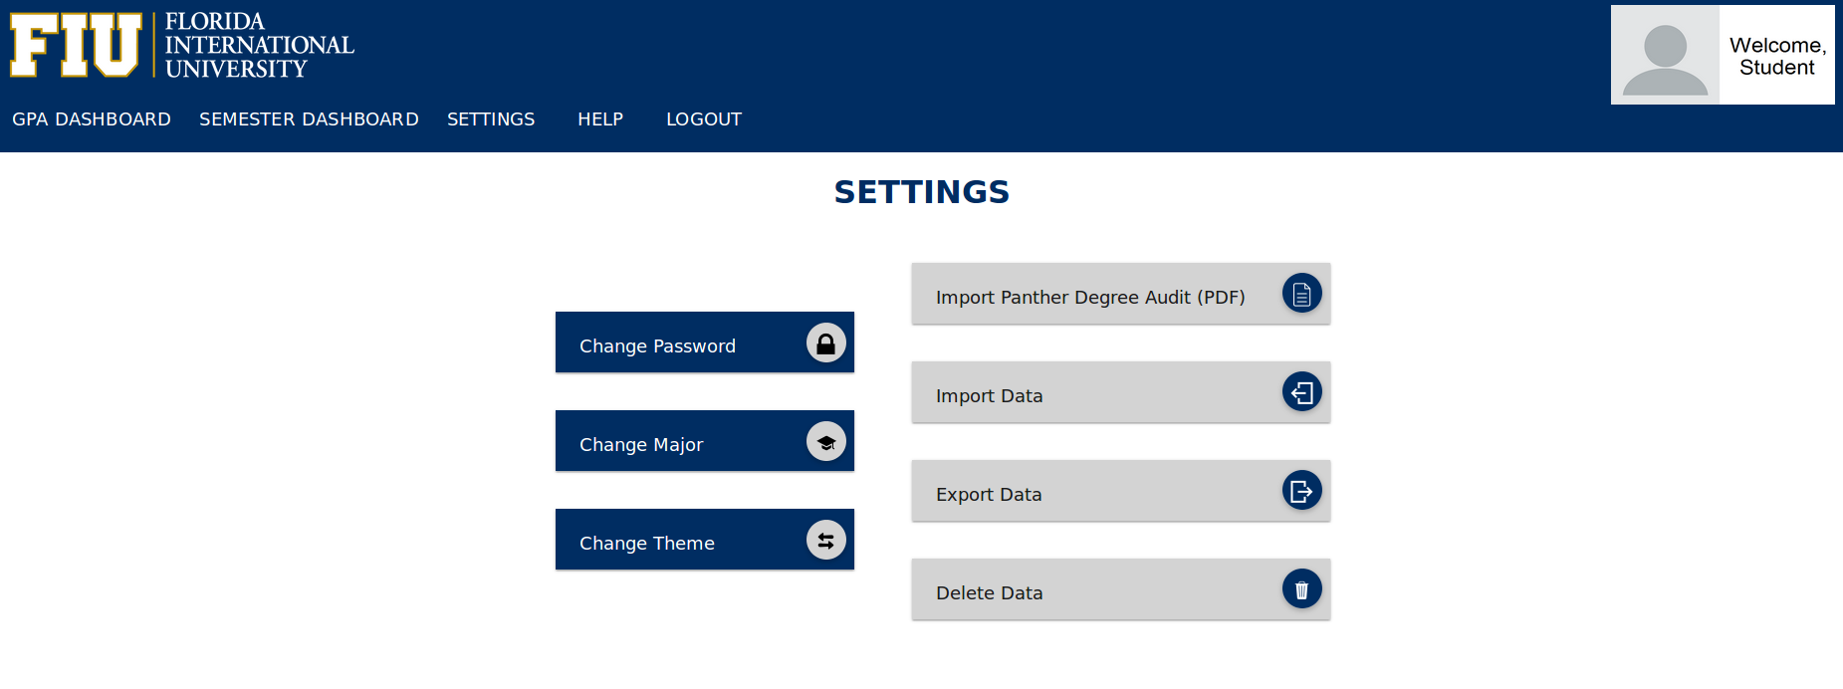
User Story #2
Migrate Settings page to AngularJS.
Tasks:
Migrate Settings navigation bar.
Migrate Import Audit button.
Update page’s look and feel.
Migrate Import Data button.
Migrate Export Data button.
Migrate Delete Data button.

Slide 11
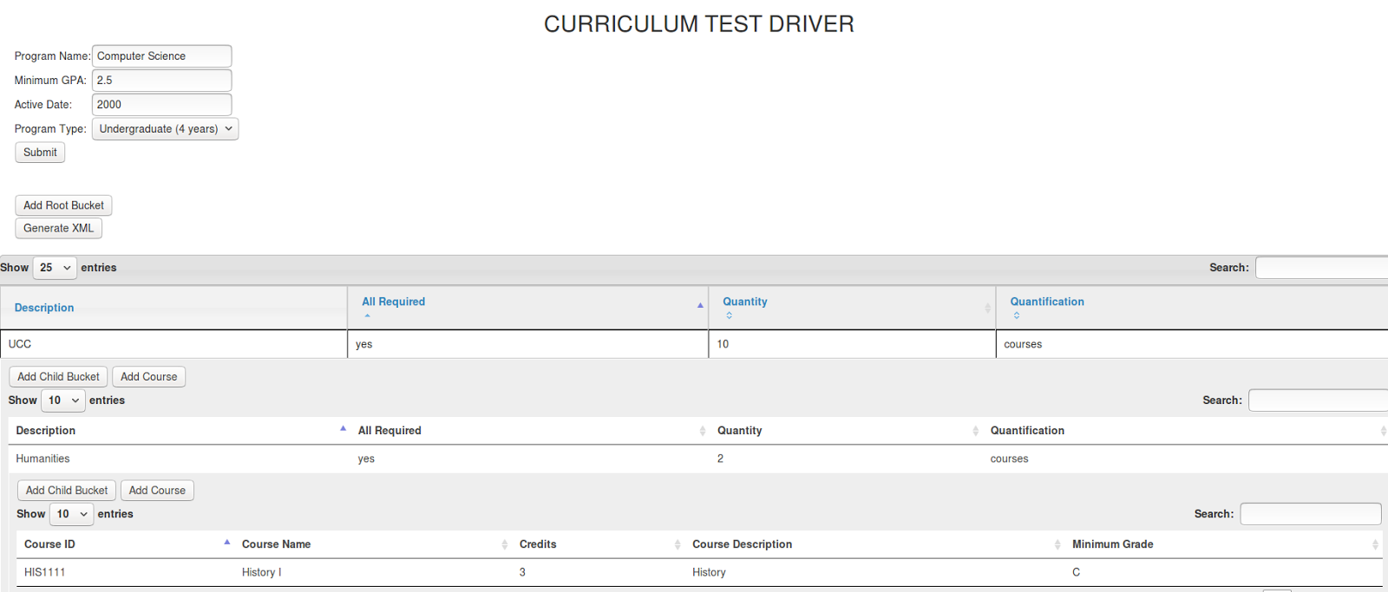
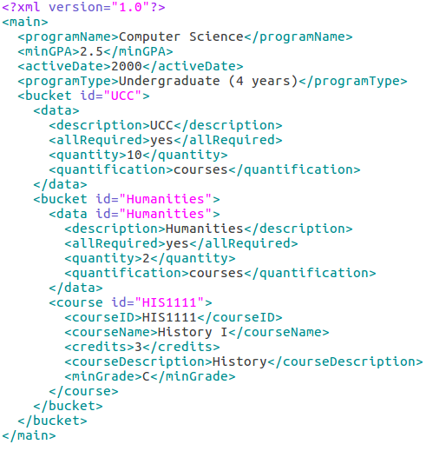
User Story #3
Tasks:
Fix infinite child addition functionality.
Fix issue pertaining course addition.
Conduct testing on test drivers.
Fix issues about basic functionality of test drivers.
The user can add infinite levels of child buckets, and add as many courses to each bucket as needed.
Screenshots show one root bucket, one child bucket, and one course in the table and the generated XML.

Slide 12
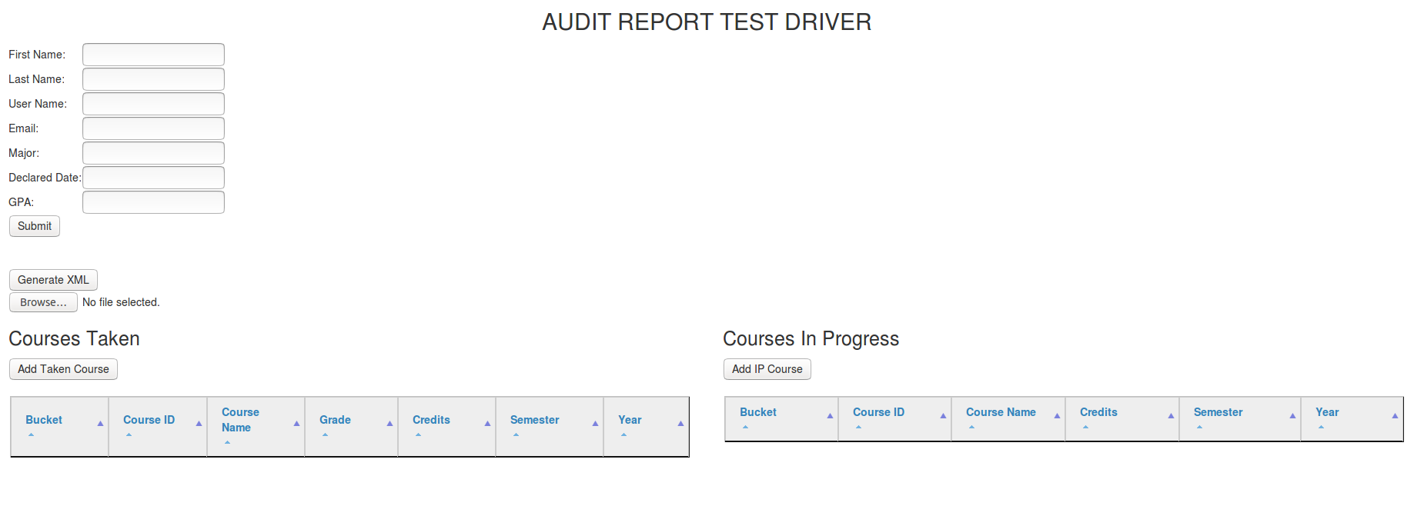
User Story #4
Integrate Test Driver XML files with Curriculum and GPA Audit Import.
Tasks:
Fix admin import feature.
When admin user imports a new curriculum generated by the Curriculum Test Driver, the database is updated with the new program.
Add import functionality to Audit Test Driver.
When this functionality is used a new student is automatically registered with the input information.
Testing purposes.

Slide 13
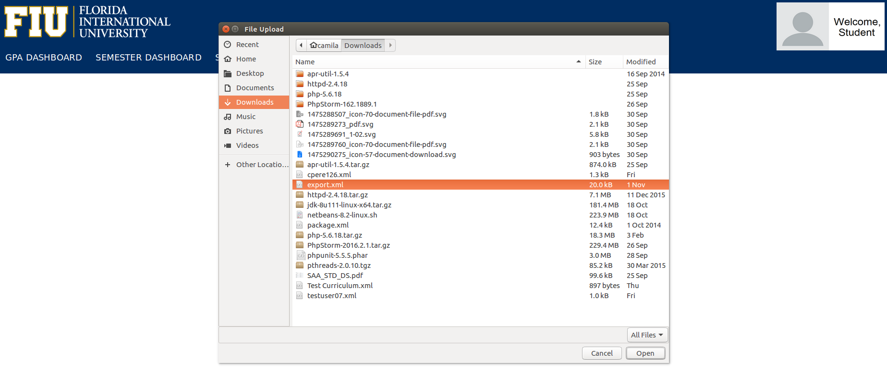
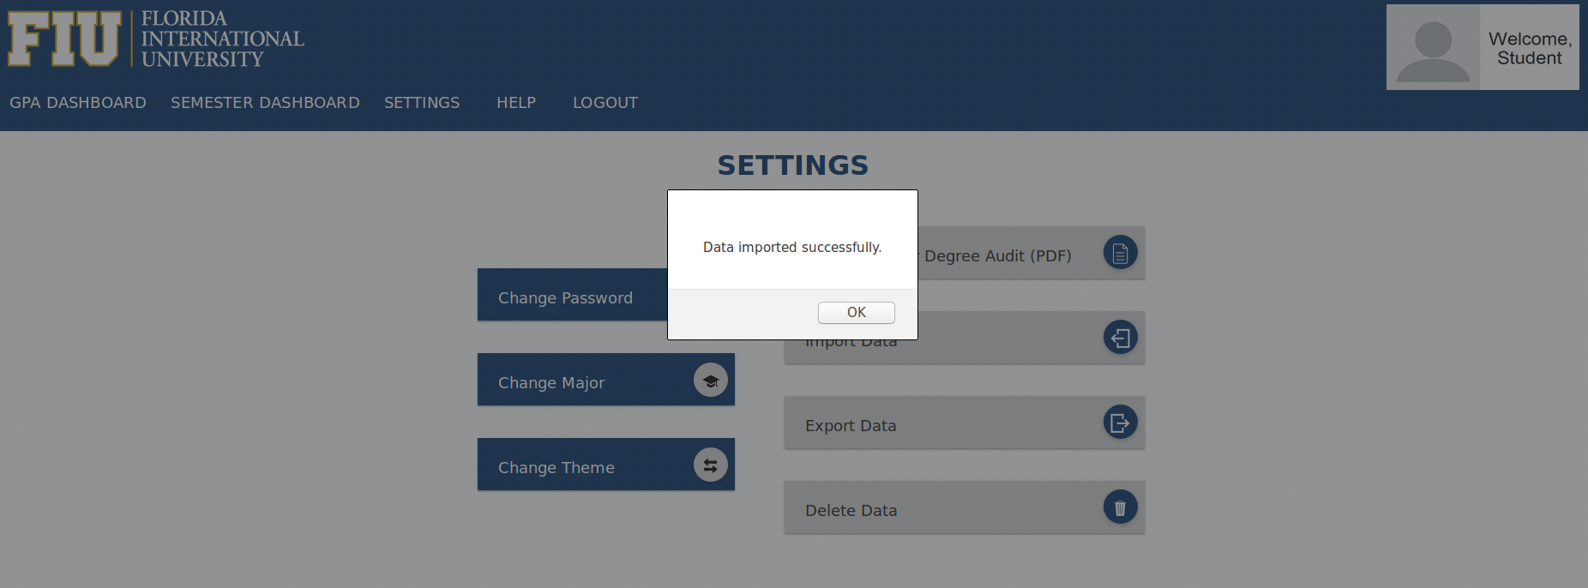
User Story #5
Fix Import Data functionality.
Tasks:
Troubleshoot Import Data functionality.
Fix Delete Data functionality.
Test import/export/delete functionalities.

Slide 14
User Story #6
Do full regression test of GPA Dashboard and fix bugs encountered.
Tasks:
Fix “invisible” next/previous buttons and other GPA Dashboard icons.
Refactor GPA Dashboard code.
Conduct full integration testing.
Buttons and icons are clearly shown in an organized and intuitive way.
Every button works as expected.

Slide 15
User Story #7
Understand and document PHP Unit Tests for GPA Dashboard.
function testGetCurrProgram001_UT004() {
$odc = new OverallDashboardController(31, 'testuser01');
$return = $odc->getCurrProgram();
$expected = "Computer Science";
$this->assertEquals($return, $expected);
}
Tasks:
Fully understand how PHP unit tests work.
Document PHP unit tests for GPA Dashboard .

Slide 16
Test Cases
Test Case | Sunny Day
Purpose | To test that the “Import Data” button properly imports the data.
Precondition | User logged in. Settings page displayed
Input Values | The user clicks on the “Import Data” button. The user selects the XML file to be imported from the file uploader window.
Expected Output | Data for this user is updated correctly.
Test Case | Rainy Day
Purpose | To test that a student cannot import an XML file that was previously exported by other student.
Precondition | User logged in. Settings page displayed
Input Values | The user clicks on the “Import Data” button. The user selects an XML file belonging to other user.
Expected Output | Message “Failed loading XML” displayed.

Slide 17








Summary
The FIU GPA Tracker and Forecaster represents a useful tool for students who want to attain a goal GPA in order to graduate, get into graduate school, or simply improve their GPA.
Questions?
Thank you!
Camila Perez
cpere126@fiu.edu

